Slide 1






Module 3.3a
How do we train a computer to make decisions?
Living and Working with Artificial Intelligence
Fishy Feature Space Activity #1:
Reef vs Non-Reef
Images of Fish on loan from Code.org’s AI for Oceans
Developed for the AI4GA (Artificial Intelligence for Georgia) project funded by National Science Foundation awards DRL-2049029 and DRL-2048502.
This work is licensed under the Creative Commons. Attribution-NonComercial-ShareAlike 4.0 International License. https://creativecommons.org/licenses/by-nc-sa/4.0/

Slide 2
Learning Objectives
Students should be able to:
Explain how decision tree classifiers work. (They should have gotten this from Pasta Land but it’s reinforced here.)
Show how training examples can be encoded as feature vectors.
Use MachineLearningForKids to set up and solve a machine learning problem.

Slide 3
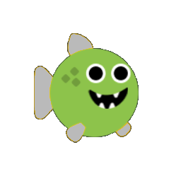
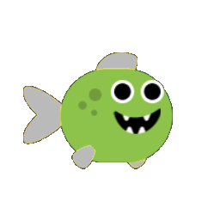
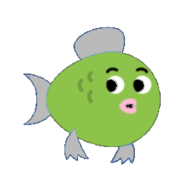
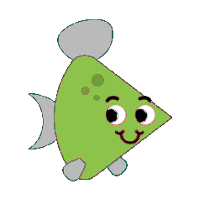
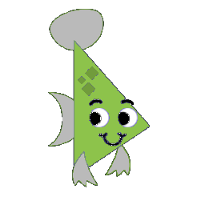
Feature 1: Body Type
The three fish on your activity sheet have the following body types:
1=circular 2=oval 3=egg 4=wedge 5=triangle
In your activity sheet table, replace the question marks for the Body Type column with the correct body type number.
Notes:
Teacher Note - Features are not binary. Notice for the body type we have 5.

Slide 4
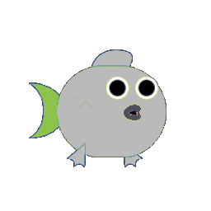
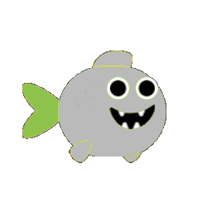
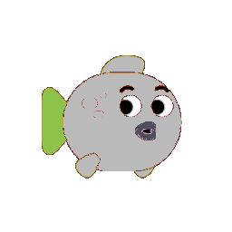
Feature 2: Tail Fin Types
The three fish on your activity sheet have the following tail fin types :
1=crescent 2=heart 3=hanger
In your activity sheet table, replace the question marks for the Tail Fin column with the correct body type number.

Slide 5
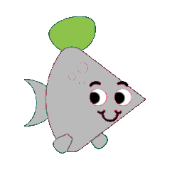
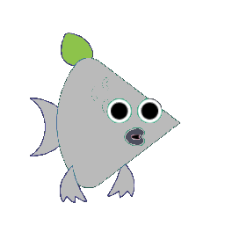
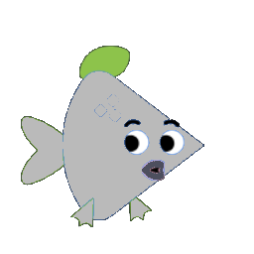
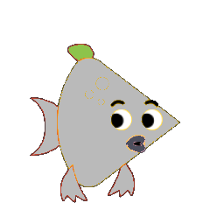
Feature 3: Dorsal Fin Types
The three fish on your activity sheet have the following Dorsal Fin types:
1=lens 2=leaf 3=swept_forward 4=swept_back
In your activity sheet table, replace the question marks for the Dorsal Fin column with the correct Dorsal Fin type number.

Slide 6
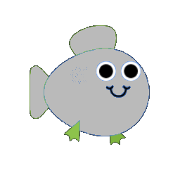
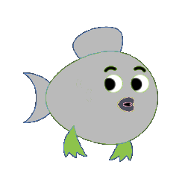
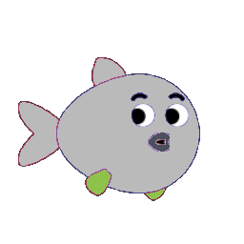
Feature 4: Pectoral Fin Types
The three fish on your activity sheet have the following Pectoral Fin Types:
1=sharp_points 2=curved_points 3=smooth
In your activity sheet table, replace the question marks for the Body Type column with the Pectoral Fin Type number.

Slide 7
Feature 5: Body Colors
The three fish on your activity sheet have the following body colors:
1=Red
5=Lime
2=Pink
6=Forest
3=Yellow
7=Blue
4=Orange
8=Purple
In your activity sheet table, replace the question marks for the Body Color column with the correct Body Color number

Slide 8
Feature 6: Fin Colors
The three fish on your activity sheet have the following Fin types:
1=Red
5=Lime
2=Pink
6=Forest
3=Yellow
7=Blue
4=Orange
8=Purple
In your activity sheet table, replace the question marks for the Fin Color column with the correct Fin Color number

Slide 9
What does it feel like to be a machine learning algorithm?
Notes:
Take Away - We are asking a computer to design the tree to learn a concept that it has no notion of. So it doesn’t know what features are relevant or what values of those features are important. It has to figure it out from the training data.
So that we are not cheating we will pick a concept we also don’t know of in advance. We will learn along with the computer. That way we will know what it feels like to learn the way that the computer learns.

Slide 10

The human who is training you has provided you two fish, and told you that one lives on a reef, and the other does not.
Use these two fish to develop 5 rules that can decide if a fish lives on a reef or not on a reef.
Non-reef:
Reef:
Notes:
REVISE THIS
Teacher Note - Here are two fish note that we can’t tell by just looking at the fish which is a reef dweller. But the training data will tell us. We are relying on the labels from the training data to tell us which fish is a reef dweller.
Look at the top right corner - we are listing all the feature where these two fish differ.
We will pick our first feature on the list and test that feature (see decision tree)
We are trying to come up with an explanation for the training data. We are trying to come up with a rule …Since we have so little data so far .. some of these will drop out as we see more data.
We have four pairs that Each one of these pair is a different way of using the features
If we choose the first feature, is it orange we conclude not reef
Anything other than orange is a reef dweller
If we choose the second feature
Take away - Note the pairs are not expressing the same rules. They are expressing alternative rules.
The two elements in each pair will produce different predictions for some fish.
There are 8 different rules that we are looking at.
Any rule could be our potential decision tree -

Slide 11

The human has provided new training data!
Check these new fish with your rules! If a rule that you came up with no longer applies, change the text color to red so that we know not use it anymore.
If all of your rules are red, erase a rule and build a new rule.
Non-reef:
Reef:
Notes:
Note - fix the table to show that these have been ruled out. We have eliminated half of the candidate rules because they produce the wrong answer for half of the examples.
We still don’t know what the correct rule is.
There is not enough information to select among the candidates.

Slide 12
Here is another fish! Do your rules still work? Change / add what you need to your table! Remember to mark broken rules in red.
Non-reef:
Reef:
Notes:
It is possible for a training example to not tell you anything that you didn’t a;ready know

Slide 13

Here is another fish! Do your rules still work? Change / add what you need! Remember to mark broken rules in red.
Non-reef:
Reef:

Slide 14


Here is another fish! Do your rules still work? Change / add what you need! Remember to mark broken rules in red.
Non-reef:
Reef:
Notes:
As we see more examples we can have greater confidence that we have the right rule.

Slide 15
Here is the last fish! Do your rules still work? Change / add what you need! Remember to mark broken rules in red.
Non-reef:
Reef:

Slide 16
What was the rule that decided if a fish lived on a reef or not? Fill in the box for part 3.
Notes:
Answer: Fish with egg-shaped bodies live in the reef.

Slide 17
Turn your rule into a decision tree! For part 4, Double click the drawing to edit it.
Turn your rule into a question, and write it in the rectangle.
Where should the fish live if the answer is yes? Fill in the correct bubble with the correct location.
Where should the fish live if the answer is no? Fill in the correct bubble with the correct location.

